Slide 1
Git Branching Strategies and Power BI
Jake Duddy

Slide 2
Problems in Power BI Deployments
Version Control
Collaboration
Oversight
Validations

Slide 3
Power BI Project (PBIP)
Power BI Report binary File (.pbix) decompiled into Folder and File Structure
Semantic Model and Report are represented as separate Fabric Items
Each Item type in Microsoft Fabric has different supported formats and required Parts (files) that make up its definition
Only some parts are mandatory
Brings Source Control (GIT) to Power BI
📁 Project Folder
├── 📁 example.Report
│ ├── 📁 .pbi
│ │ └── 📄 localSettings.json # *
│ ├── 📄 .platform
│ ├── 📄 definition.pbir # ! Pointer to Semantic Model
│ └── 📄 report.json # ! Report Definition
├── 📁 example.SemanticModel
│ ├── 📁 .pbi
│ │ ├── 📄 localSettings.json # *
│ │ ├── 📄 editorSettings.json
│ │ └── 📄 cache.abf # * Cached copy of model and data
│ ├── 📄 diagramLayout.json
│ ├── 📄 .platform
│ ├── 📄 definition.pbism
│ ├── 📄 model.bim # ! Semantic Model Definition as TMSL │ └── 📁 definition # ! Or TMDL
└ .gitignore
* Git ignored
! Required
https://learn.microsoft.com/en-us/power-bi/developer/projects/projects-overview

Slide 4






Deployment Methods
Git Integration
Fabric Workspace connected to Azure DevOps (ADO) Repo branch
Fabric Items can be synced both ways
GUI or Fabric APIs
Fabric APIs
Create Item
Update Item Definition
ADO
Fabric
Workspace
Semantic Models
Reports
Post
/workspaces/{workspaceId}/items/{itemId}/updateDefinition
Post
/workspaces/{workspaceId}/items
https://learn.microsoft.com/en-us/fabric/cicd/git-integration/intro-to-git-integration
https://learn.microsoft.com/en-us/rest/api/fabric/core/items
Notes:
https://github.com/microsoft/Analysis-Services/tree/master/pbidevmode
# Install-Module Az.Accounts -Scope CurrentUser -Force
$tenantId = "2a1d3328-87c0-4f85-90c6-0bb69b1c4978"
Import-Module "$pwd\FabricPS-PBIP" -Force
Set-FabricAuthToken -tenantId $tenantId -reset
Import-FabricItems -workspaceId "75605c88-438e-43a2-95c8-07e3bdf6e3c4" -path $pwd

Slide 5
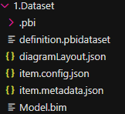
Semantic Model Item Definition
Required Parts
Model Definition
Both model.bim (TMSL) and \ definition (TMDL) are supported by API
TMSL TO TMDL Conversion with Microsoft.AnalysisServices.Tabular.Tmdlserializer no longer required
https://learn.microsoft.com/en-us/analysis-services/tmdl/tmdl-overview
https://learn.microsoft.com/en-us/analysis-services/tmsl/tabular-model-scripting-language-tmsl-reference

Slide 6
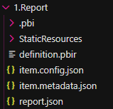
Report Item Definition
Required Parts
definition.pbir
definition.pbir points to Semantic Model either byConnection or byPath
Fabric API only supports byConnection
https://learn.microsoft.com/en-us/power-bi/developer/projects/projects-report

Slide 7

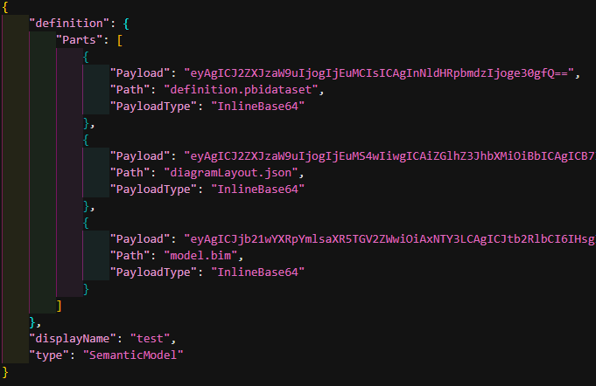
Example Request
URI
Header
Body
Post
/workspaces/{workspaceId}/items/{itemId}/updateDefinition

Slide 8
Pipelines and Triggers
Pipelines
Jobs executed by runners (docker containers)
Runners have access to repo
Jobs to run are defined in GUI or YAML
Pipelines
Atomic elements of pipeline, stating what actions should occur
Triggers
Manual
Branch/CI Can run every time you commit changes to a branch
Merge request Can run every time you commit changes to a source branch in Merge Request
Scheduled Runs on schedule defined by cron, if changes to branch since last scheduled run
Pre Merge/Merged results
Can run every time you commit changes to a source branch in Merge Request
Run of result of source and target branches merged together
https://learn.microsoft.com/en-us/fabric/cicd/git-integration/intro-to-git-integration
https://learn.microsoft.com/en-us/rest/api/fabric/core/items

Slide 9

Workspace Pattern
Semantic Models
Dataset
Dev
Reports
Dataset
Test
Workspace 1
Dev
Workspace 1
UAT
Workspace 1
Prod
Report Consumer(s)
Dataset
prod
Notes:
Split Semantic Models into separate items, owned by separate roles
Datasets
Single workspace, unless sensitive data and different workspace permissions required
1 repo per Semantic Model
Clean git history
Simple scope
Different reviewer and approvers per dataset
git integration not possible
Reports
Single workspace for each use case/audience
Limit scope of sharing to intended audience
Easier discoverability and navigation
git integration and deployment pipelines are possible
Some reports can have a composite model to enhance a underlying semantic model to add report specific features that would otherwise add mess
field parameters, measures for conditional formating
Need to consider whole-sales and retail execution, composite model doesn’t understand calculation groups in remote model

Slide 10
Adding Git
Semantic Models
Dataset
Dev
Report Developer(s)
Sematic Model 1
Semantic Model Owner
Sematic Model 2
Sematic Model 3
Reports
Dataset
Test
Workspace 1
Dev
Workspace 1
UAT
Workspace 1
Prod
Report Consumer(s)
Dataset
prod
Notes:
Split Semantic Models into separate items, owned by separate roles
Datasets
Single workspace, unless sensitive data and different workspace permissions required
1 repo per Semantic Model
Clean git history
Simple scope
Different reviewer and approvers per dataset
git integration not possible
Reports
Single workspace for each use case/audience
Limit scope of sharing to intended audience
Easier discoverability and navigation
git integration and deployment pipelines are possible
Some reports can have a composite model to enhance a underlying semantic model to add report specific features that would otherwise add mess
field parameters, measures for conditional formating
Need to consider whole-sales and retail execution, composite model doesn’t understand calculation groups in remote model

Slide 11
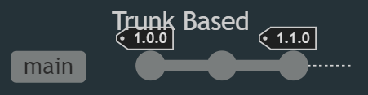
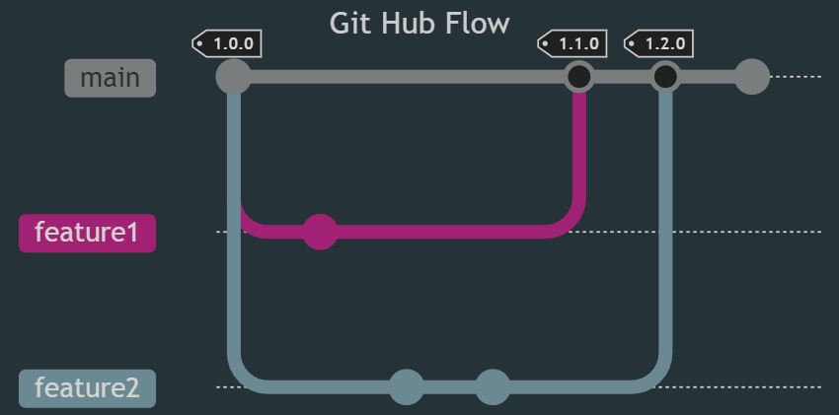
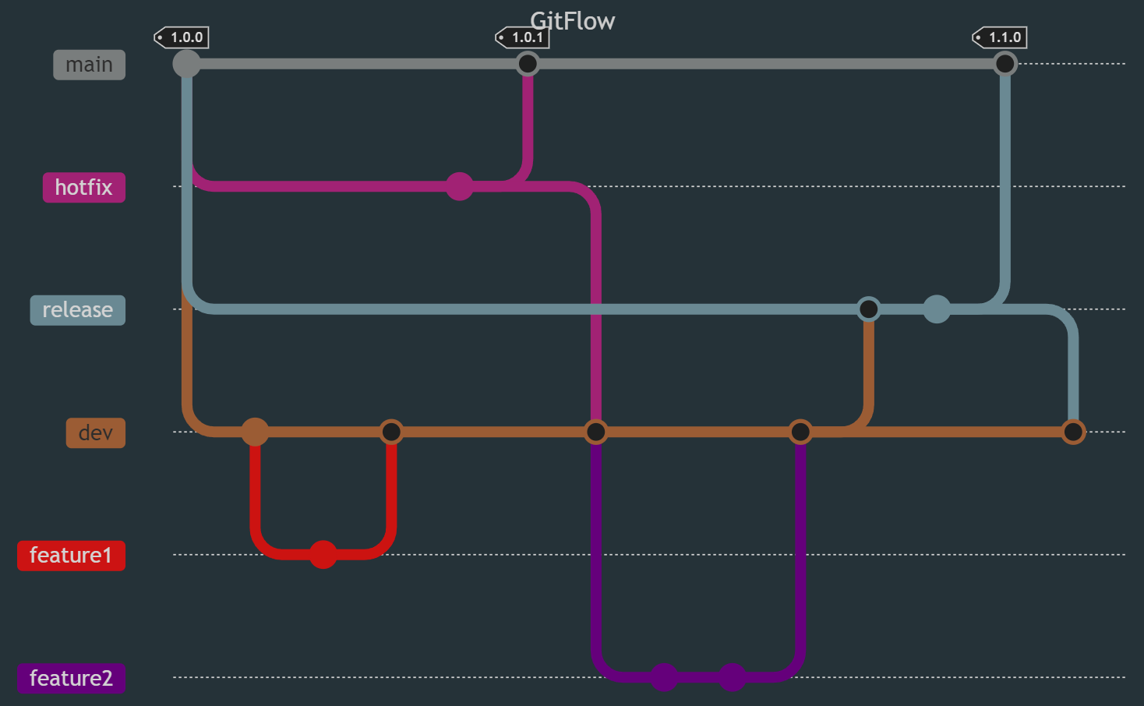
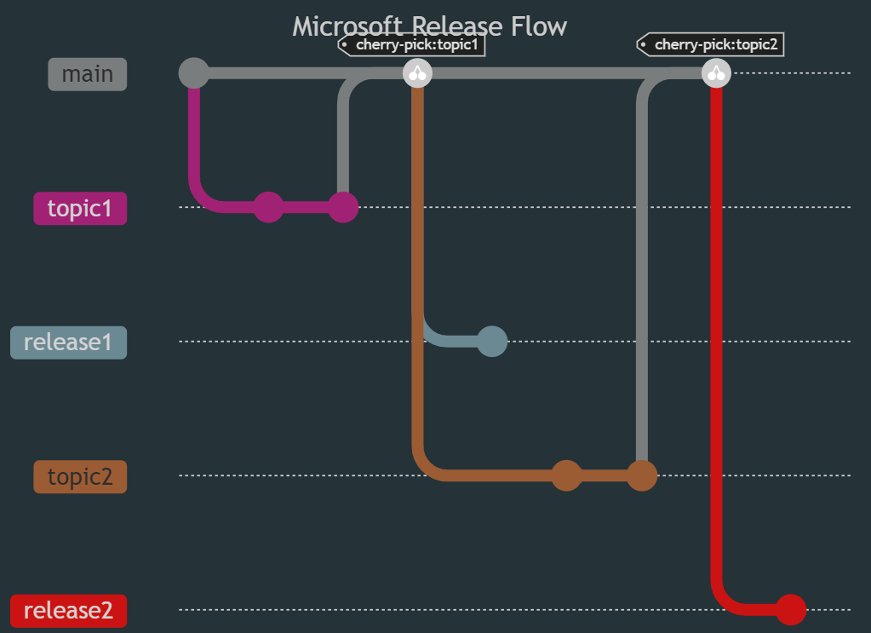
Branching Strategies

Slide 12



Git Integration
Local Machine
Deployment Via Git Integration
commit
pbip
push origin
Azure DevOps
GitHub Flow
feature3
feature2
1.0.0
1.0.1
feature1
main
Microsoft Fabric
Deployment Pipeline
Workspace
Dev
Workspace
Test
Workspace
prod
Semantic Models
Semantic Models
Semantic Models
Reports
Reports
Reports

Slide 13

Fabric APIs
Local Machine
Deploy Fabric Items via deployment script in Azure pipelines on Pull Request
commit
push origin
pbip
Azure DevOps
Git Flow
feature3
feature2
feature1
dev
release
hotfix
1.0.0
1.0.1
main
Microsoft Fabric
Workspace
Prod
Workspace
Dev
Workspace
Test/UAT
Semantic Models
Semantic Models
Semantic Models
Reports
Reports
Reports

Slide 14
Pipeline Enhancements
Power BI APIs
Update Parameters In Group
Bind To Gateway In Group
Refresh Dataset (Full/Enhanced)
Post
groups/{groupId}/datasets/{datasetId}/Default.UpdateParameters
Post
groups/{groupId}/datasets/{datasetId}/Default.BindToGateway
Post
/datasets/{datasetId}/refreshes
https://learn.microsoft.com/en-us/rest/api/power-bi/

